Slide 1
2.2 Media: Tools and Materials

Slide 2
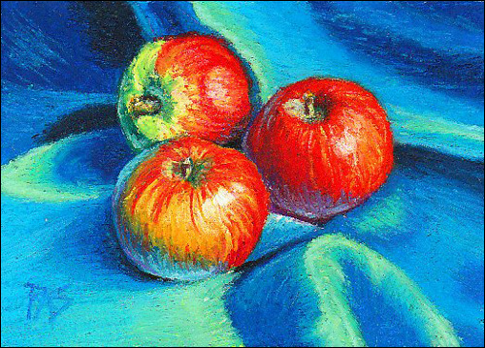
Drawing Media
Pencil- https://www.youtube.com/watch?v=xm1x9ibCO28
Charcoal- teacher example
Ink- teacher example
Pastel-

Slide 3
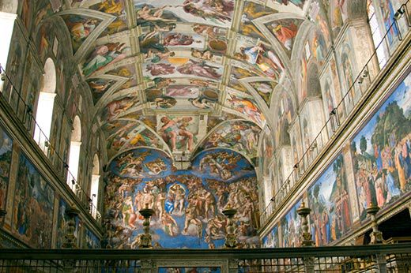
Painting Media
Fresco-

Slide 4
Painting media
Tempera Paint
Oil-teacher example
Watercolor- https://www.youtube.com/watch?v=ZIqWPohGmmM
Acrylic-Teacher example
Collage- teacher example

Slide 5
Printmaking Media
Woodcut- https://www.youtube.com/watch?v=vsMBA-1g-5U
Intaglio- https://www.youtube.com/watch?v=VRwWJyy24So
Linocut-teacher examples
Lithograph- https://www.youtube.com/watch?v=NeIuYLaw9ks
Serigraph- also known as silk screen

Slide 6
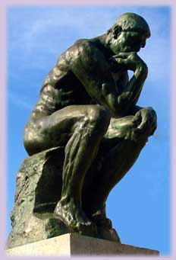
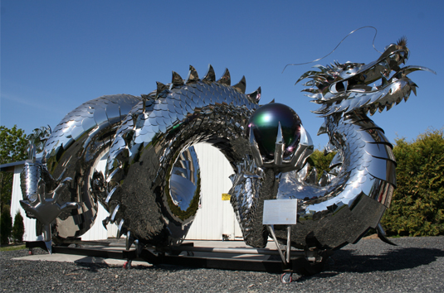
Sculpture Media
Bronze-
Steel-

Slide 7
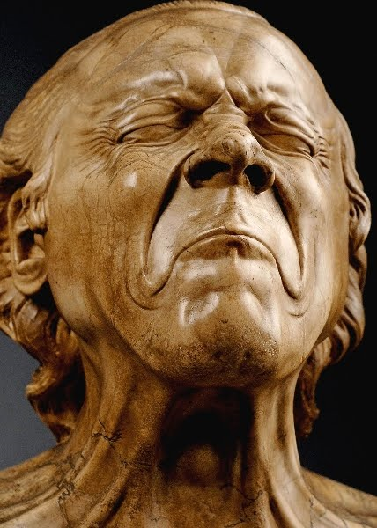
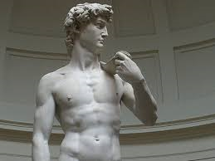
Sculpture Media
Wood-
Marble-
Plastic

Slide 8
Crafts
Fibers-teacher example
Glass- https://www.youtube.com/watch?v=jBKxPWo12f4
Clay-teacher example
Furniture

Slide 9
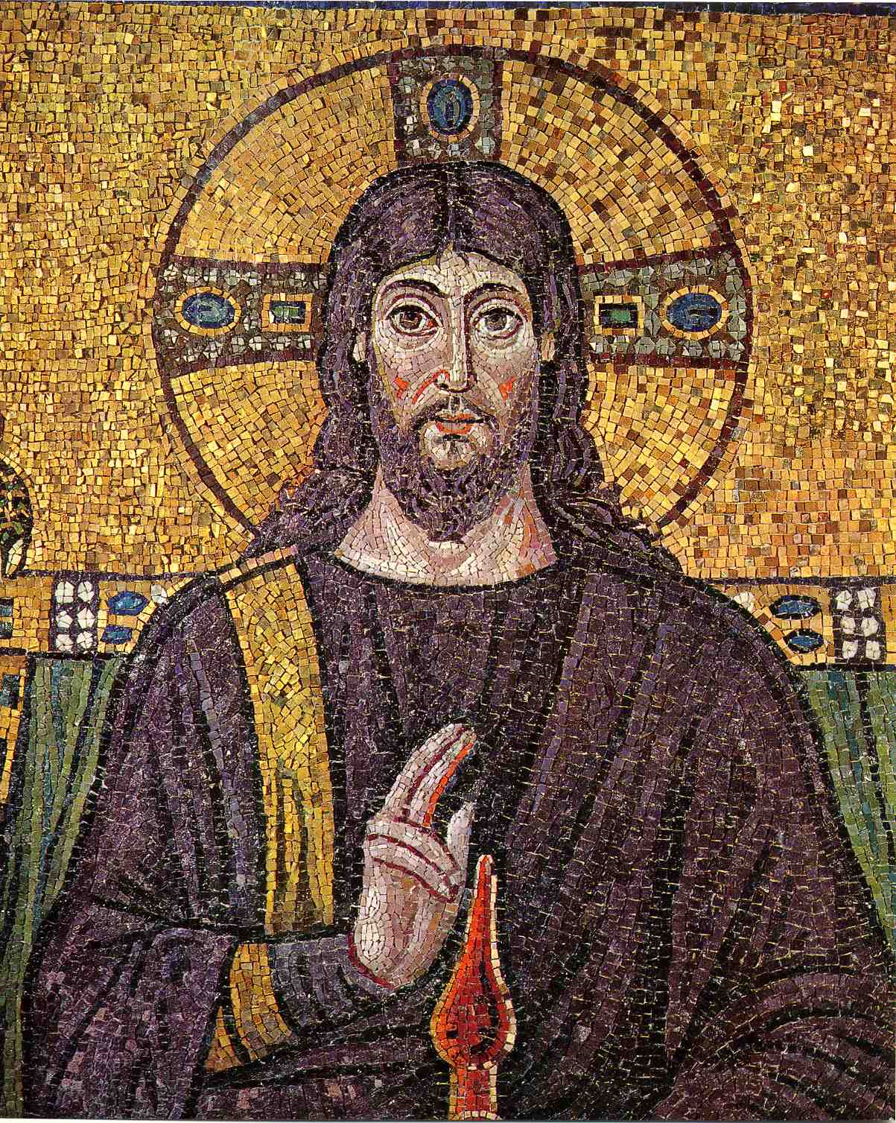
Crafts

